Slide 1
Southern California SAR data availability
Scott Baker
baker@unavco.org

Slide 3
Previous Missions
Satellite | Repeat (days) | Swath/Resolution | # So. Cal. Scenes
ERS-1/2 (C-Band) 1992-2000,1995-2011 | 35 | 100km / 30m | ~11000
Radarsat-1 (C-Band) 1996-* | 24 | 100km / 30m 50 km / 8m | ~7000
Envisat (C-Band) 2002-2012 | 35 30 (Oct. 2010) | 56-100km / 30m 400km / 150m | ~7000 ~300
ALOS (L-Band) 2006-2011 | 46 | 40-70km / 7,14m 250-350km / 100m | ~4000 ~100
JERS (L-Band) 1992-1998 | 44 | 75 km / 18m | ~550
*Still operational, but limited data availability

Slide 4
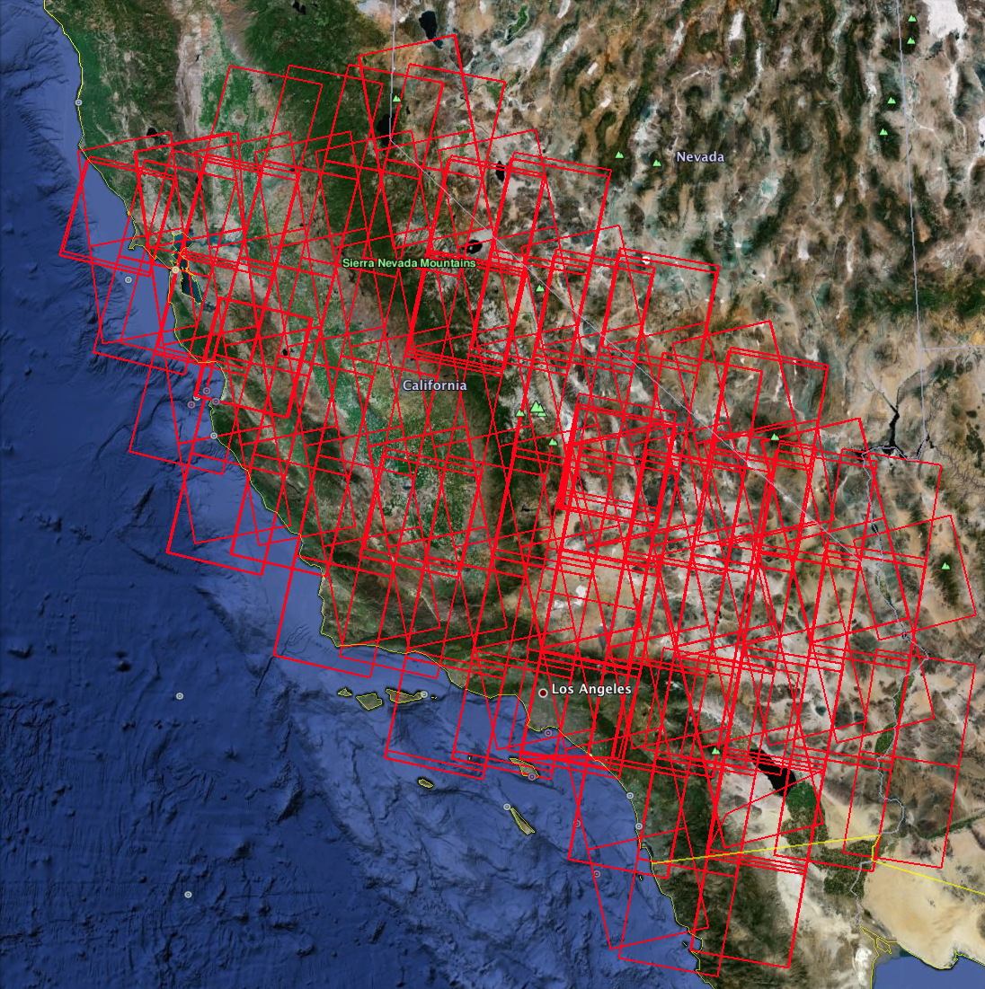
ERS
~100 acquisitions/track

Slide 5
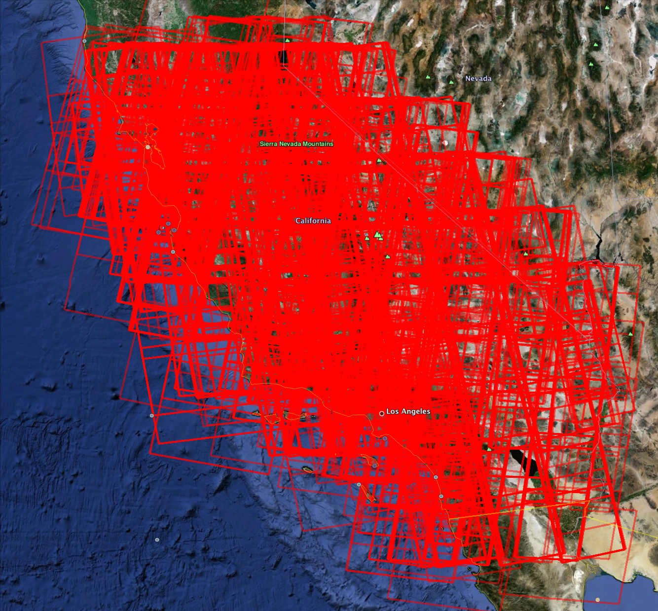
Radarsat-1
~100 acquisitions/track

Slide 6
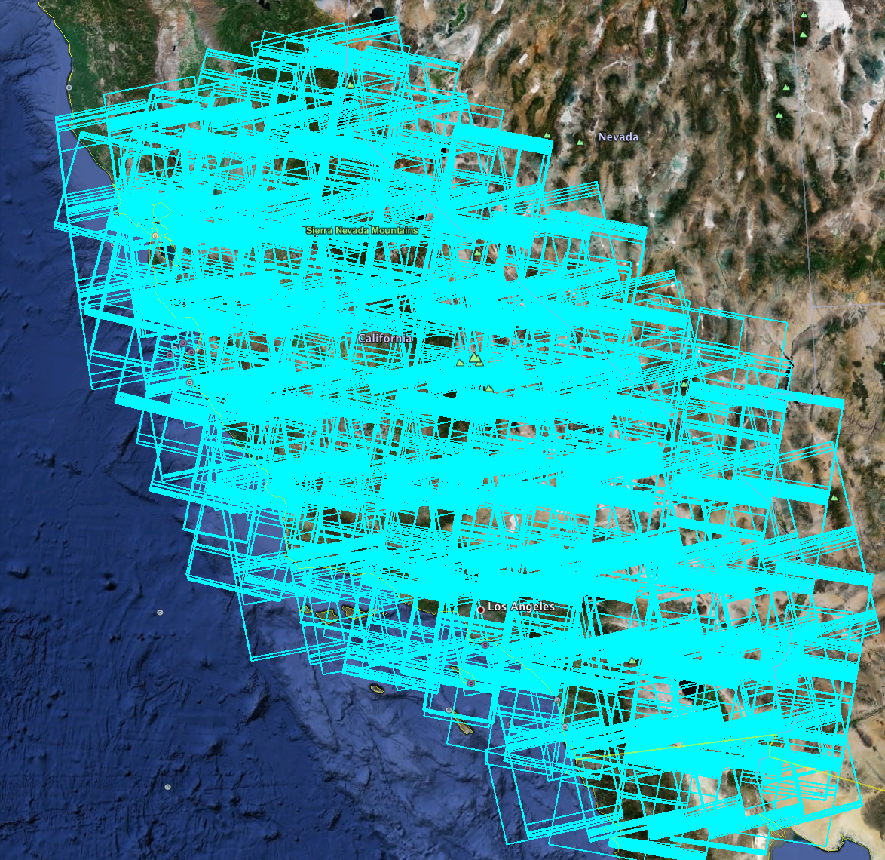
Envisat
~50 acquisitions/track

Slide 7
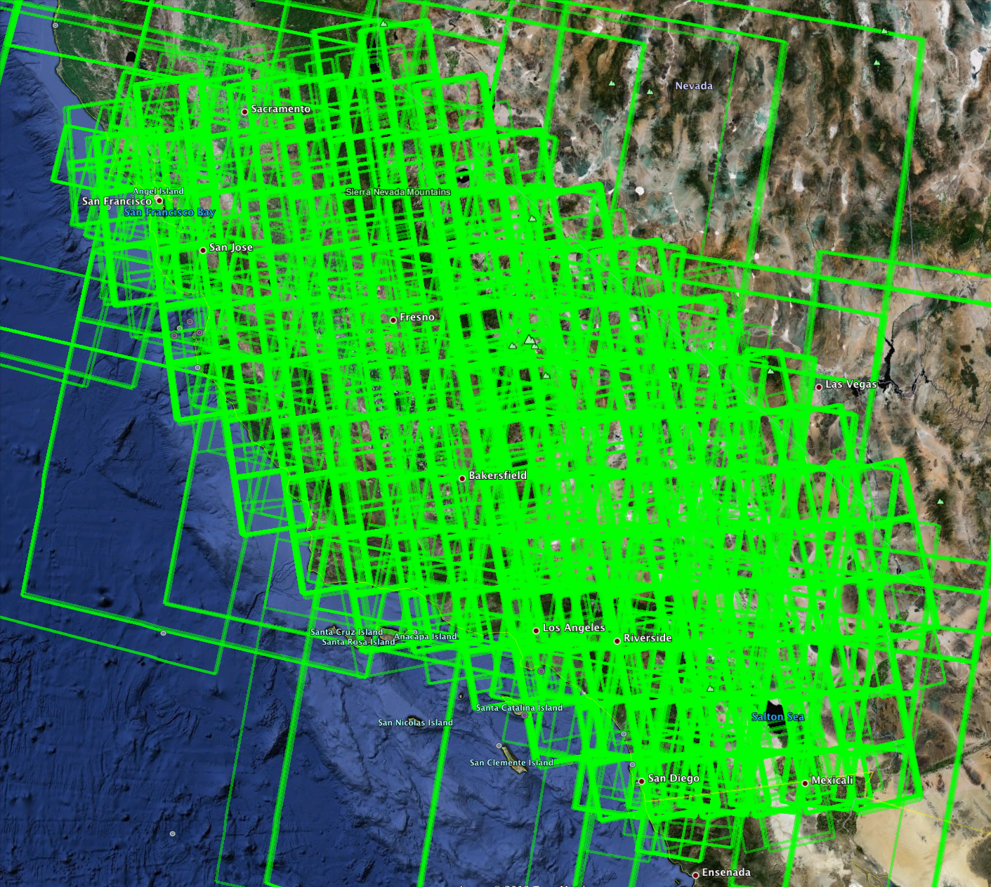
ALOS
~20 acquisitions/track

Slide 8
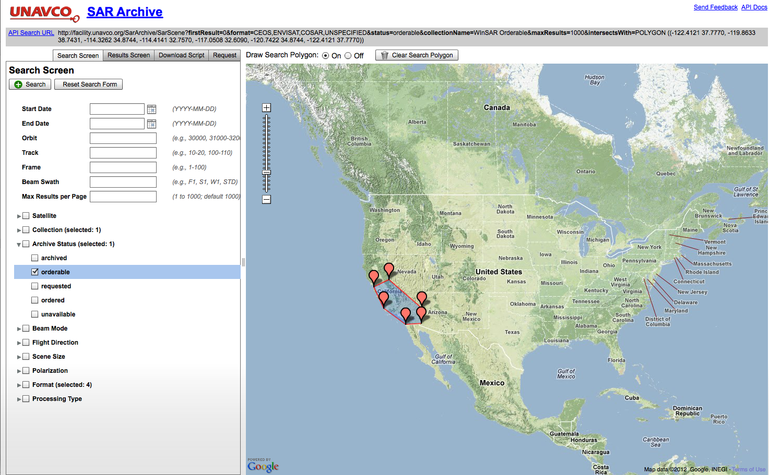
http://facility.unavco.org/data/sar/sar.html

Slide 9
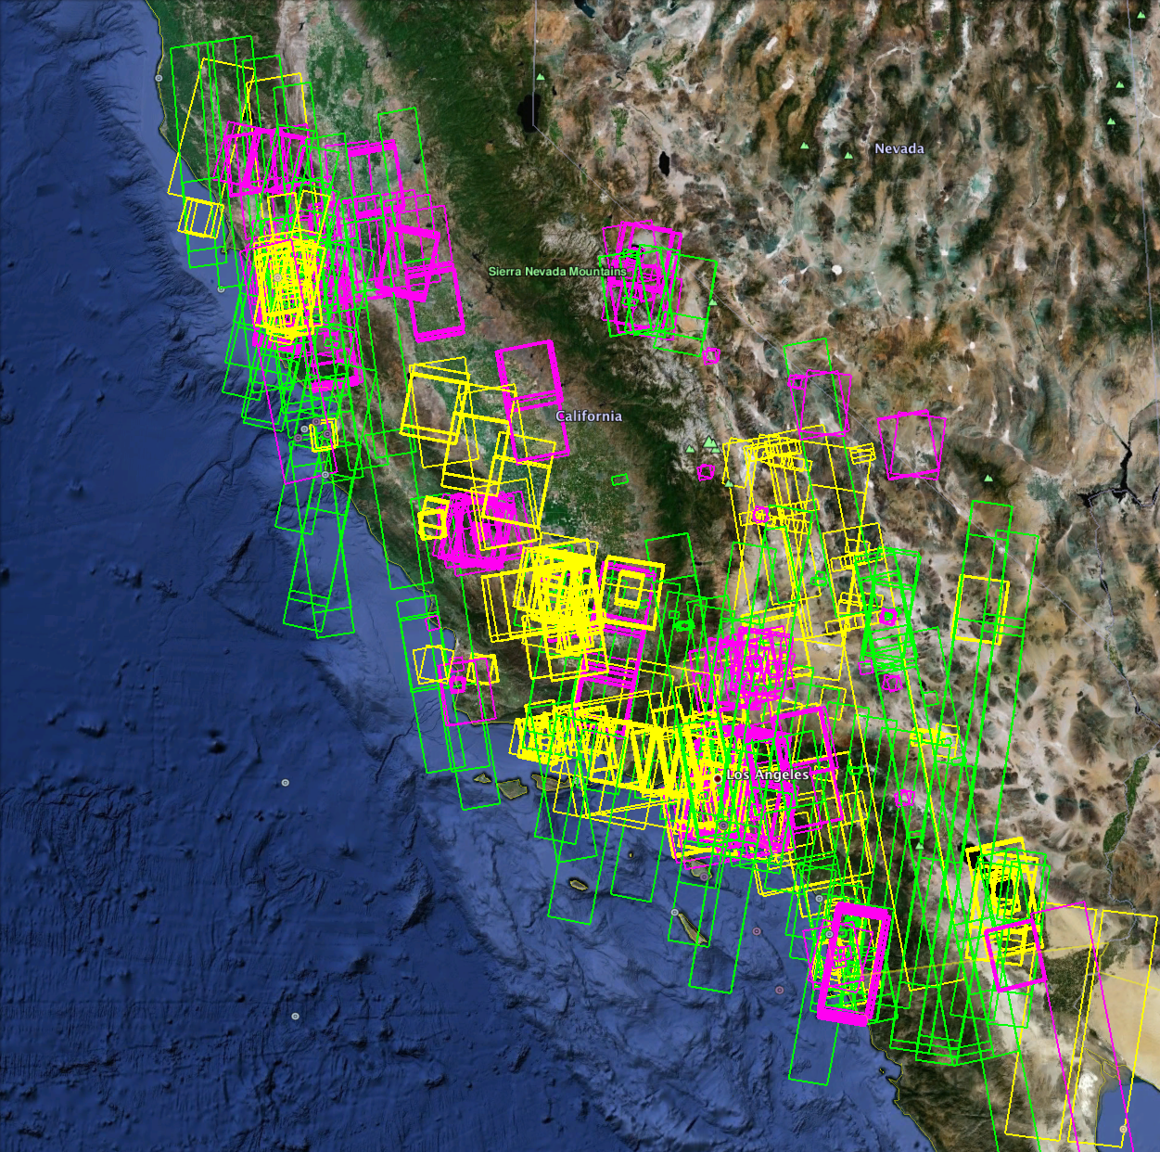
Current Missions
Satellite | Repeat (days) | Swath/Resolution | # So. Cal. Scenes
TSX-1/TDX-1 (X-Band) Nov 2007, Jun 2010 | 11 | 30km / 3m 10 km / 1m | ~800
Radarsat-2 (C-Band) April 2008 | 24 | 50 km / 10m 100km / 25m 25km / 10m | ~2000
Cosmo-SkyMed (X-Band) Jun 2007 – Nov 2010 | 16 (1-8) | 40km / 3m 10km / 1m | ~1700
Risat-1 (C-Band) April 2012 | 12 | 30km / 3-12m 120-240km / 25-50m | ??
UAVSAR | Variable | 16km / 1.8m | ~200

Slide 10
Cosmo-SkyMed, TerraSAR-X, and Radarsat-2

Slide 11
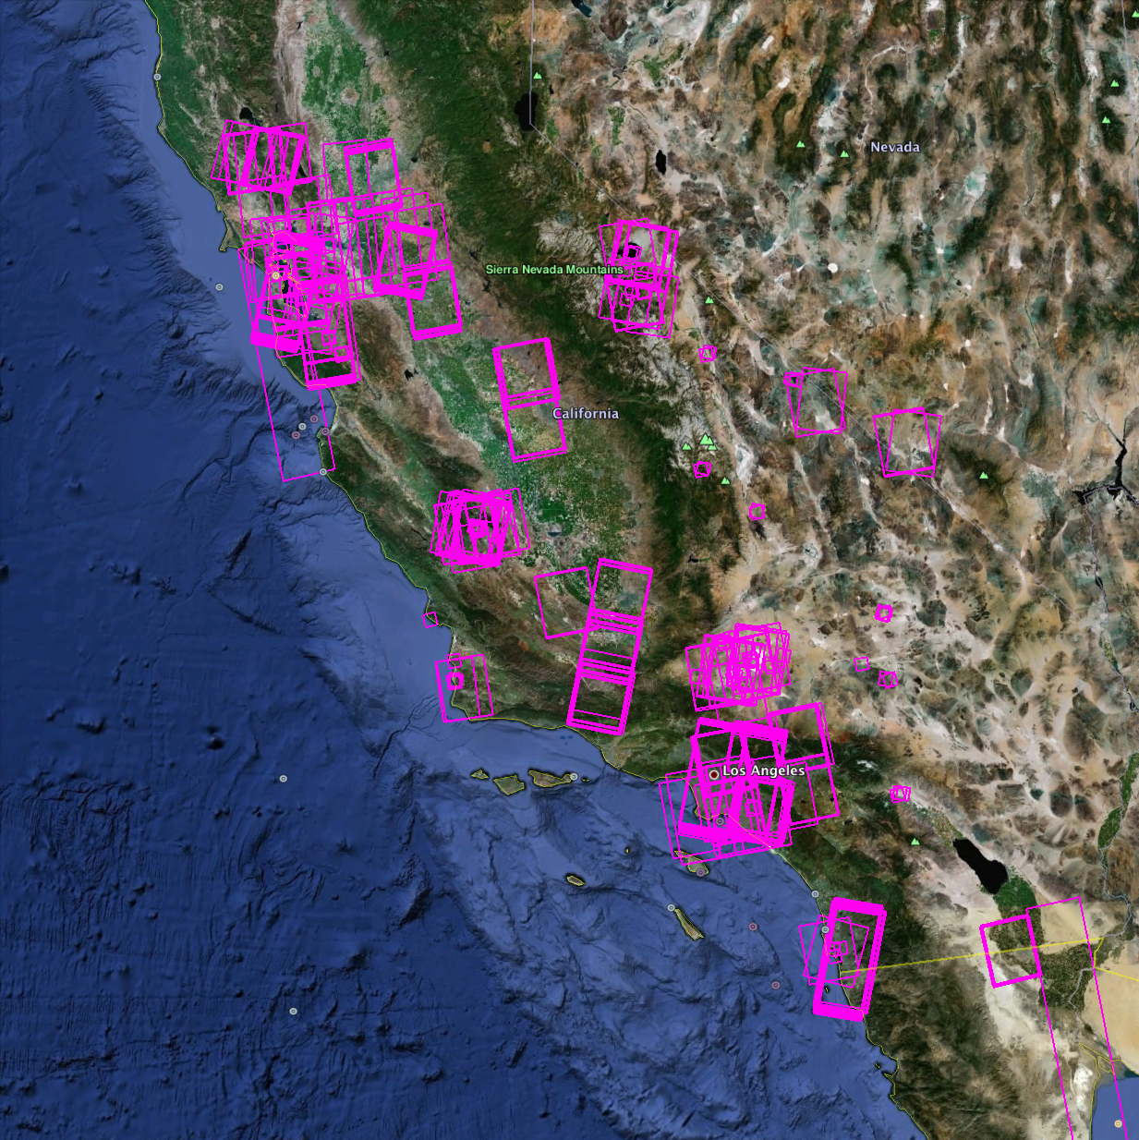
Cosmo-SkyMed

Slide 12
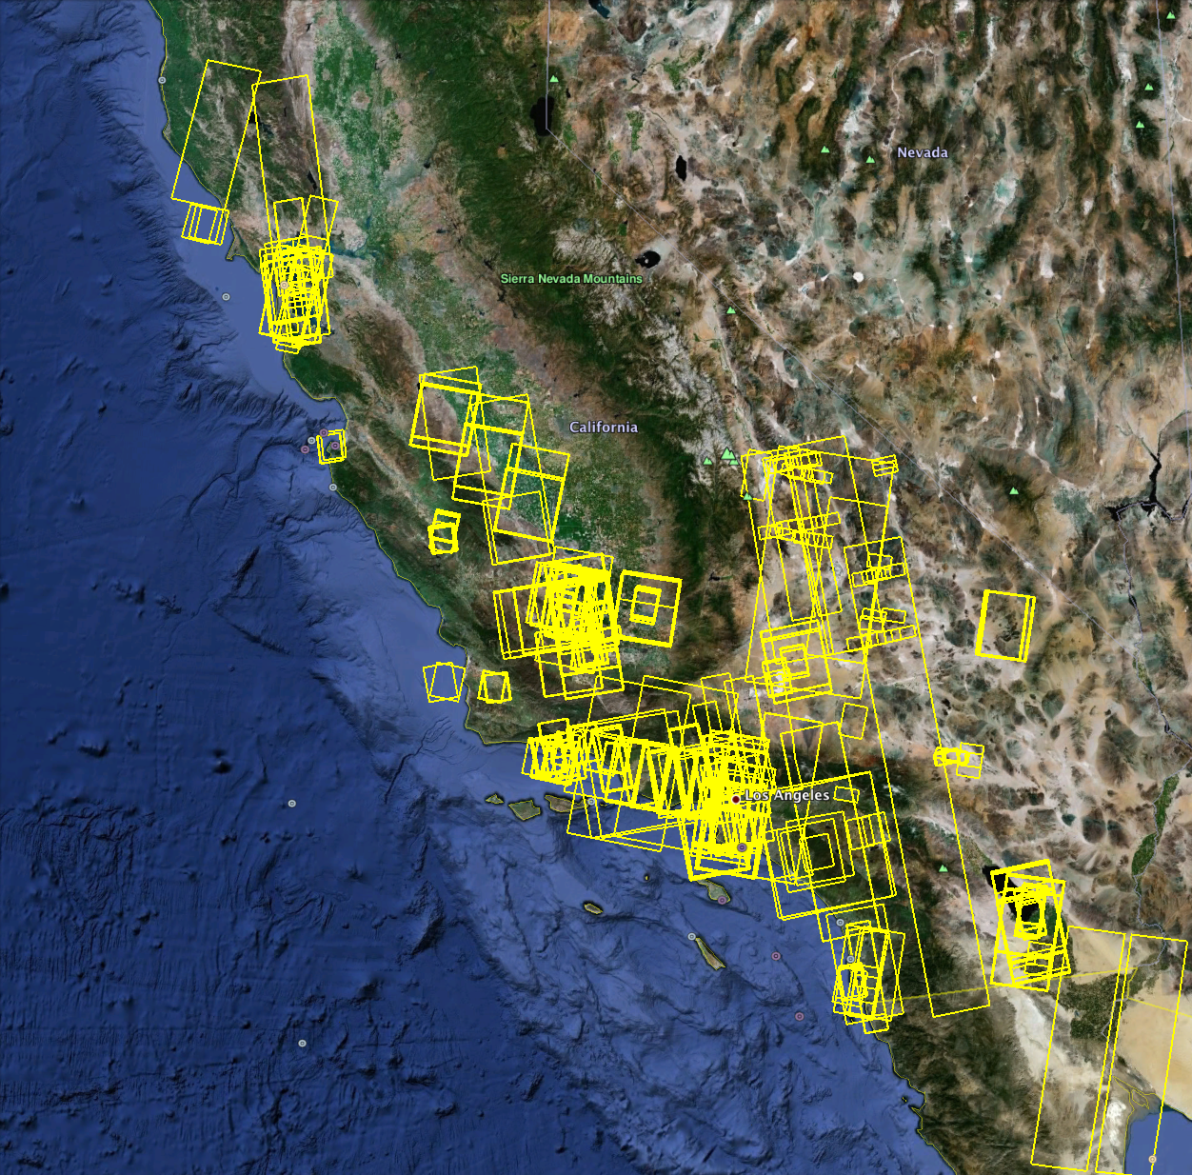
Radarsat-2

Slide 13
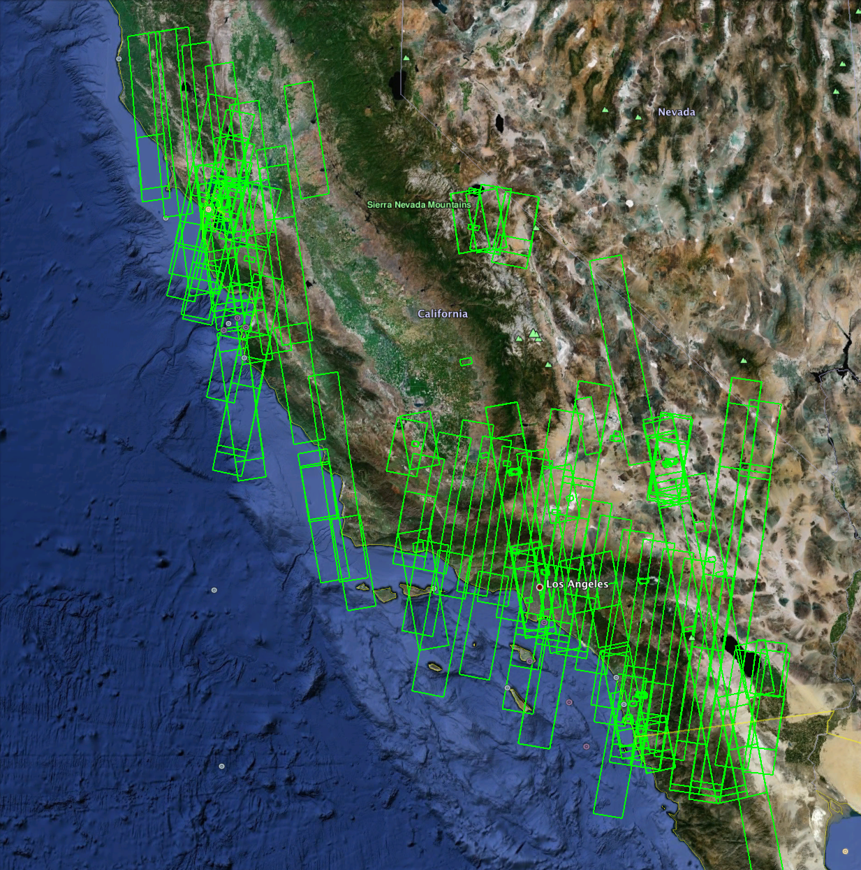
TerraSAR-X/TanDEM-X

Slide 14
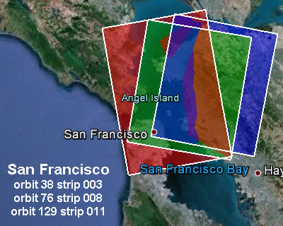
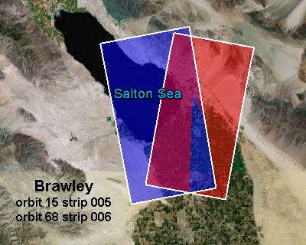
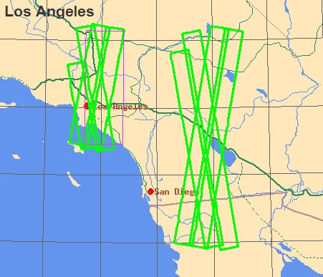
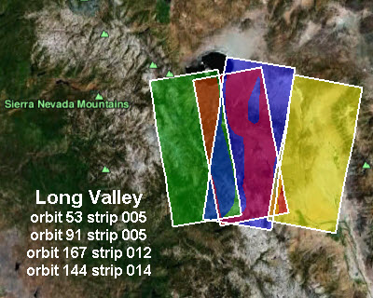
http://winsar.unavco.org/tasking_tsx.html

Slide 15
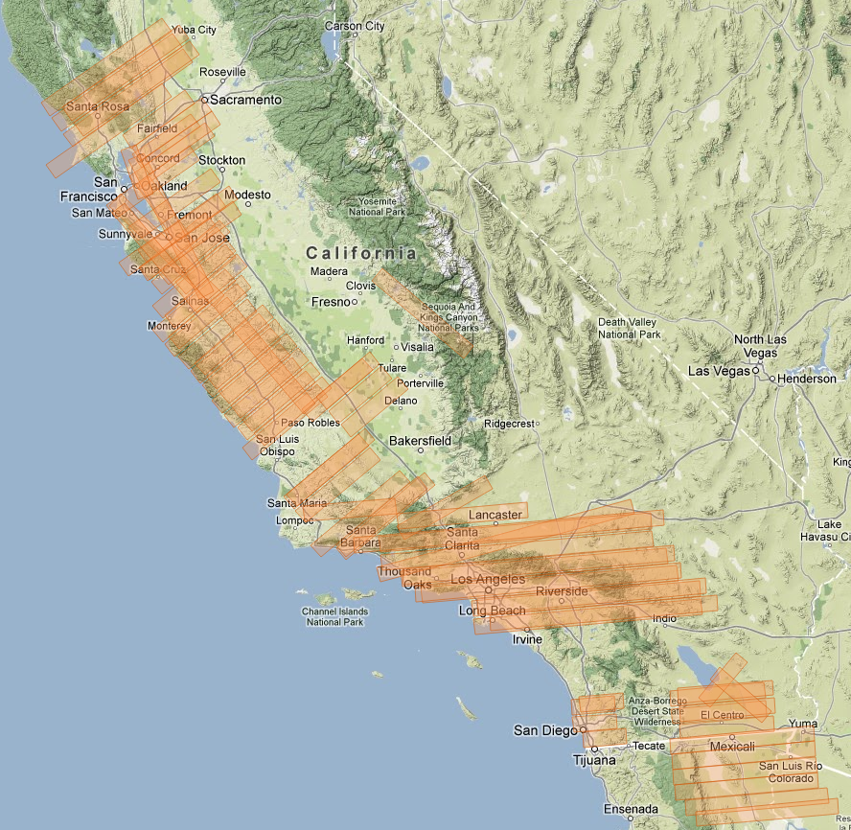
UAVSAR

Slide 17
Approved Future Missions
Satellite | Repeat (days) | Swath/Resolution | Launch Date
ALOS-2 (L-Band) | 14 | 25km/ 1-3m 50-70km / 3-10m 350km / 100m | Mid 2013
KOMPSAT-5 (X-Band) | 28 | 30km / 3m 5km / 1m | 2012
Sentinel-1a,b (C-Band) | 12 (6) | 80 km / 5m 250km / 5x20m 400km / 20x40m | Oct-Dec 2013 (a) 2015 (b)
SAOCOM-1a,b (L-Band) | 16(8) | 30km / 10m 350km / 100m | 2014-2015
Radarsat Constellation (C-Band) | 12(4) | 5km / 1x3m 20km / 3m 30km / 5m 125km / 30m | Aug 2016-Dec2017
Cosmo-SkyMed SG (X-Band) | 16 | 40km / 3m 10km / 1m | June 2015, June 2016
Data source: http://database.eohandbook.com

Slide 18
THANK YOU
QUESTIONS?

