Slide 1


Training on SBAS-DInSAR web-tool in the framework of ESA Geohazards Exploitation Platform
Francesco Casu
IREA - CNR, Napoli, Italy (casu.f@irea.cnr.it)

Slide 2
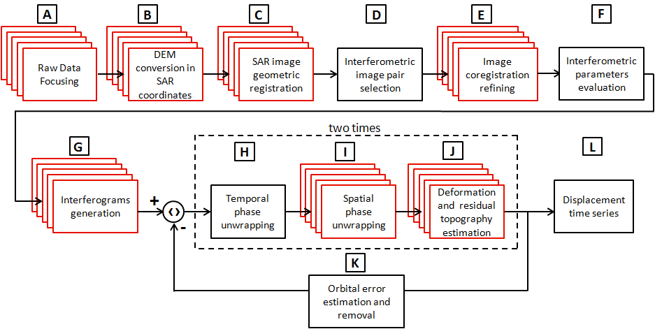
Background: Parallel SBAS (P-SBAS) workflow
Casu et al., 2014, SBAS-DInSAR Parallel Processing for Deformation Time-Series Computation, IEEE JSTARS
Zinno et al, 2015, A First Assessment of the P-SBAS DInSAR Algorithm Performances Within a Cloud Computing Environment, IEEE JSTARS
Zinno et al., 2015, Cloud Computing for Earth Surface Deformation Analysis via Spaceborne Radar Imaging: A Case Study, IEEE Transaction Cloud Computing
DUAL LEVEL PARALLELISM FOR MULTI-NODE AND MULTI-CORE ARCHITECTURES

Slide 3
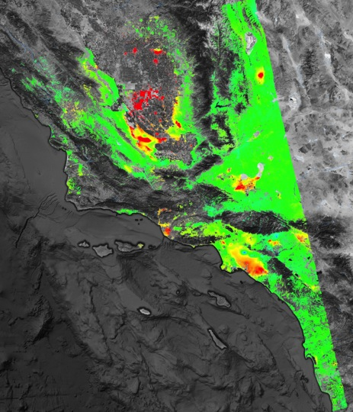

P-SBAS ENVISAT results on Amazon AWS Cloud
>1.5
350 km
Envisat “frames”: 18
Exploited Images: 741
Deformation velocity [cm/yr]
Processing Nodes: 144
550 km
Overall processing time (from RAW to Time series):
< 9 hours
Los Angeles
<-1.5
* GPS
Δ SAR
San Diego
Total cost:
< 1000 USD

Slide 4
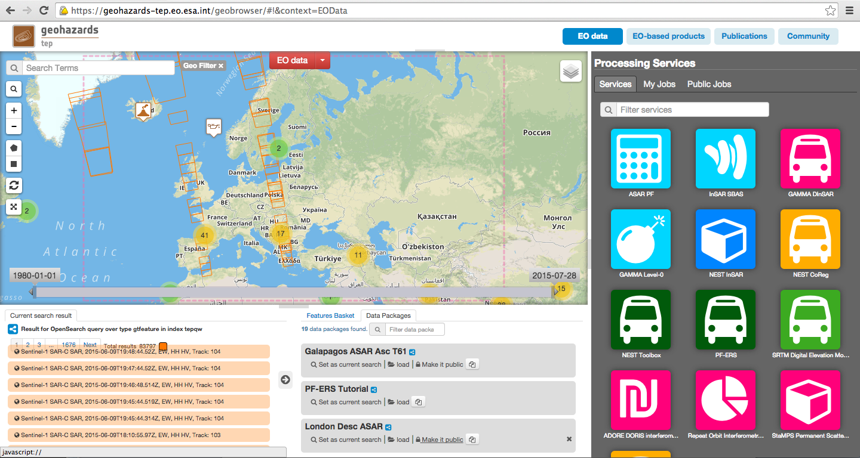
ESA Geohazard Exploitation Platform
EO data storage: ERS, ENVISAT, Sentinel (SciHub)
  Processing tools: SBAS, ROI_PAC, StaMPS, …
  Computation: Cloud and GRID (G-POD)
  Cloud sandbox
  Collaborative environment

Slide 5
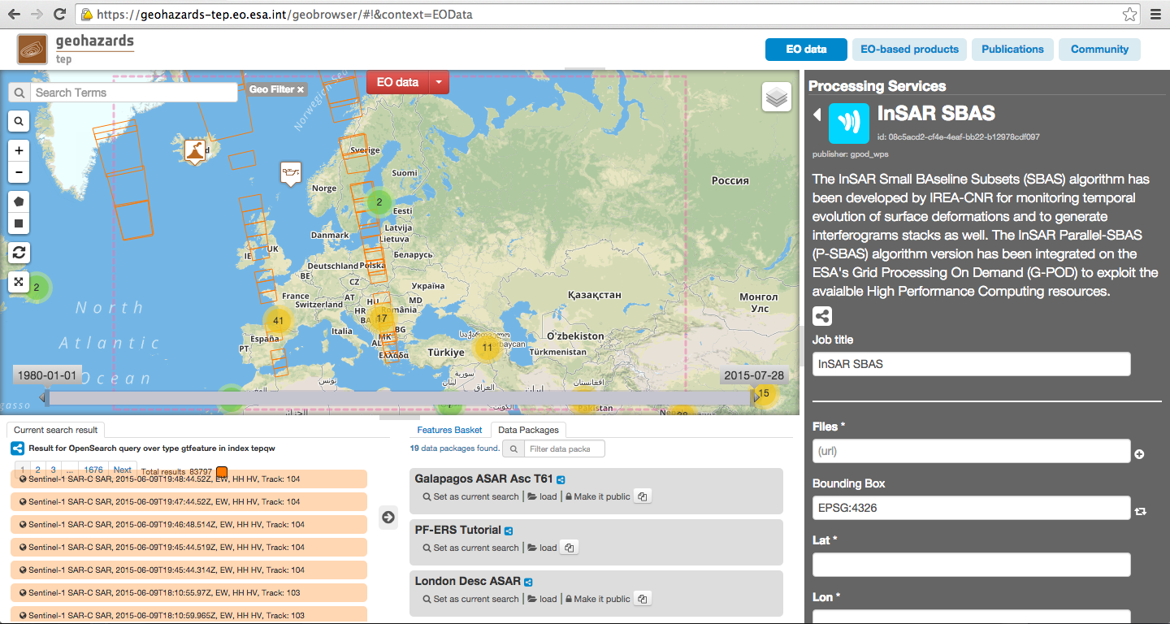
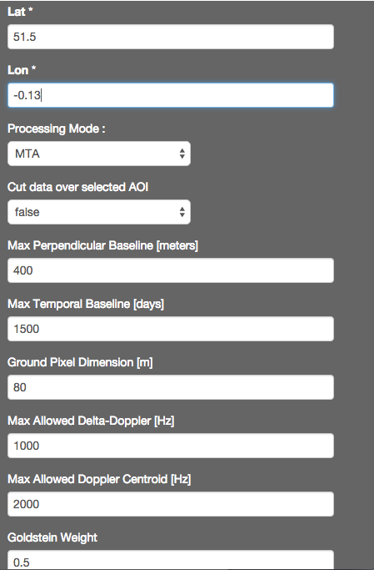
GEP P-SBAS service
Provided as Web Processing Service (WPS) via Grid Processing On Demand (G-POD) of ESA

Slide 6

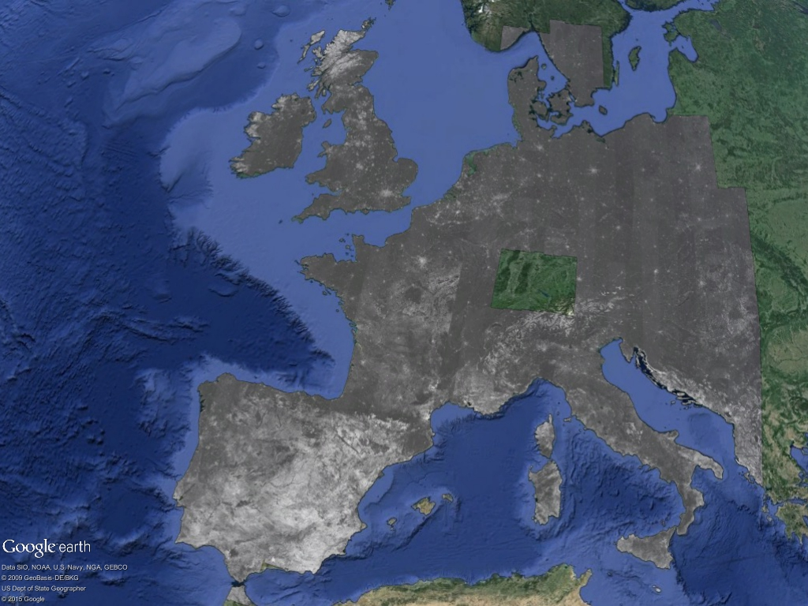
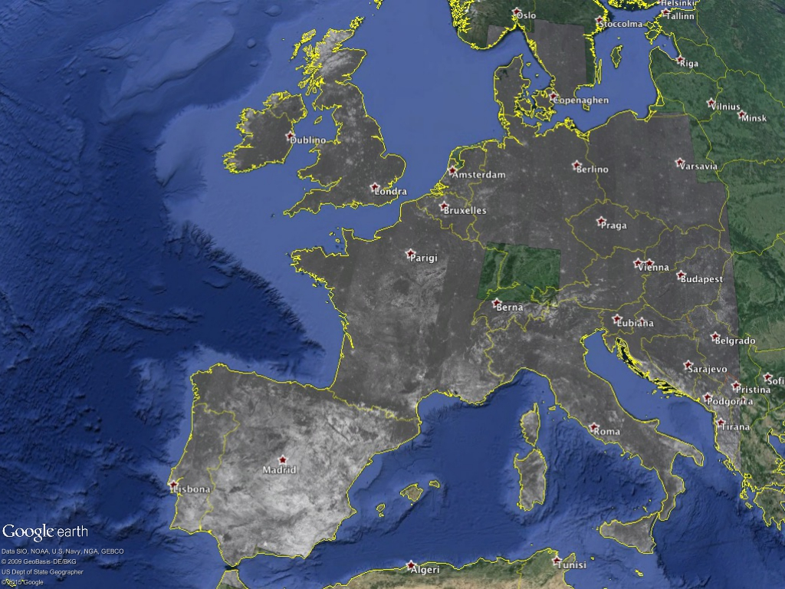

Sentinel-1A 12-days Coherence over Europe
Number of Images (Slices): 300 (150 interferometric pairs)
Time Period: June-July 2015
Processed Area : 7,500,000 km²
Covered Area: 3,200,000 km²
0
Coherence
1

Slide 7
  Training
  Thursday, Dec 17th, 1pm-4pm
  Marriott Marquis, Sierra B
  casu.f@irea.cnr.it
  Thank you!
geohazards-tep@esa.int

