Slide 1
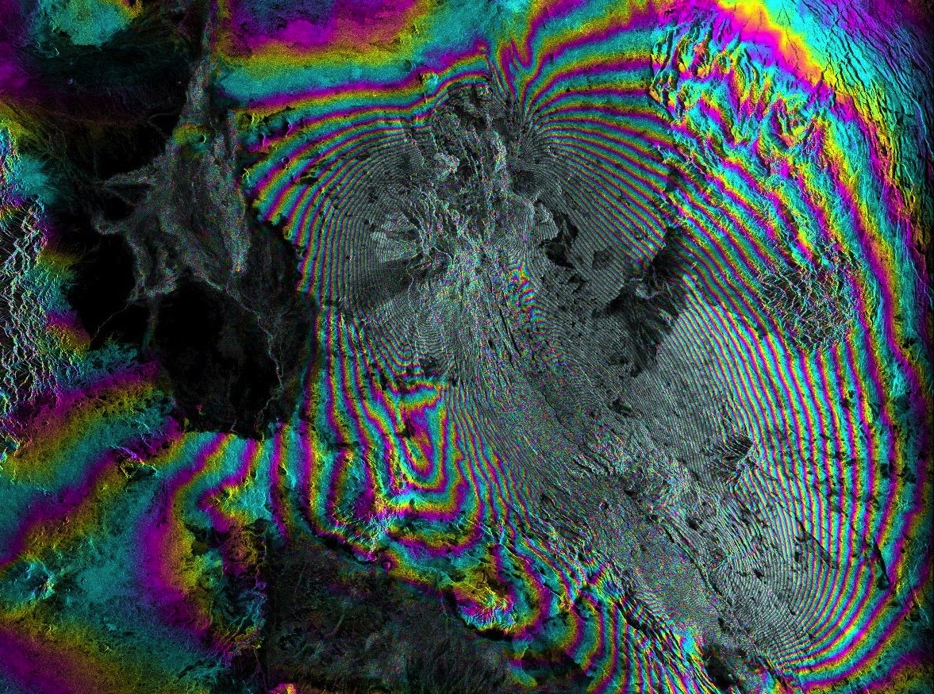
ASF DAAC Update for winsar
Scott Arko
Alaska Satellite Facility, University of Alaska Fairbanks
WinSAR Update

Slide 2
Major Milestones
Completed integration of Sentinel-1 into the DAAC data system
Sentinel-1A release in Dec 2015
Sentinel-1B integration and release in Sep 2016
Ingesting RAW, GRD, and SLC products from ESA and NASA Sentinel Gateway
New release of Vertex
Improved usability, including easier searching and results filtering
Updated libraries and removed many unneeded libraries – faster loading
Integrated with NASA CMR
Sentinel-1 data moved to the cloud
New/Active data available from multiple locations
Complete archive held at ASF DAAC in Fairbanks

Slide 3
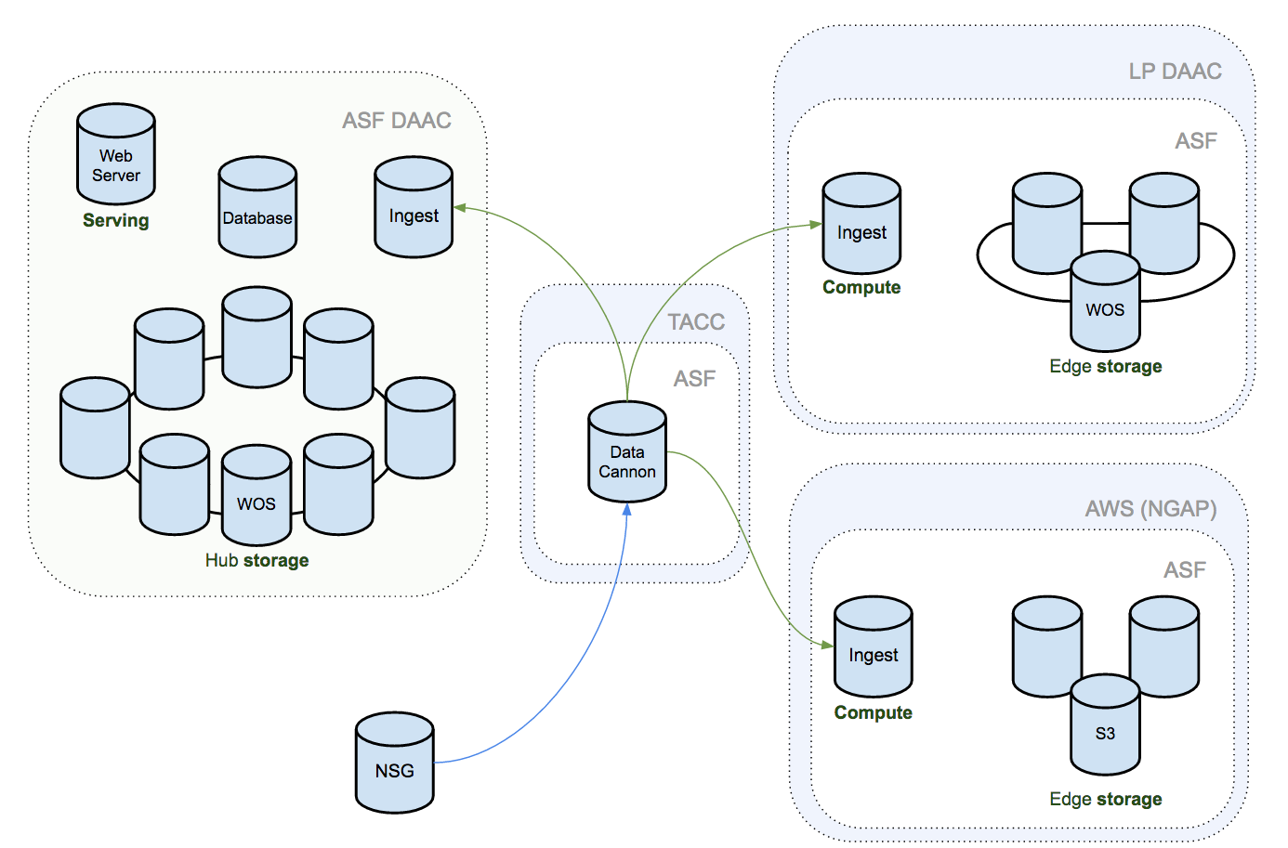
Sentinel-1 Data Architecture

Slide 4
Plans for coming year
Getting Ready for NISAR (GRFN) project
Joint project with NASA ESDIS and JPL/ARIA team
Engineering project to move DAAC functions to NISAR scales
Vertex improvements
Various improvements planned based on user input and Blink UI study
Send inputs to jclaurancelle@alaska.edu if you have things you want to see
API Improvements
Better InSAR support in the API (state vectors, baselines, …)

