Slide 1
WInSAR Operations Update
Christopher Crosby & Scott Baker
AGU WInSAR Business Meeting
December 14, 2016

Slide 2
WInSAR Operations
WInSAR Funding Reminder
Limited WInSAR support under GAGE
  - 1 FTE for management, archive ops & maintenance, tasking, data ordering, data ingest, website and community support
Supplemental support:
  - $100k SAR supplement ($50k NSF/$50k NASA)
  - $55k- Enhancing Access to UNAVCO Imaging Data - awarded to support SAR web service development and integration with existing UNAVCO services, EarthCube activities.
Activities
WInSAR web updates (early 2017)
    Merging the WInSAR website and portal
    Improvements to institutional applications, proposal management, publication sharing
Cloud storage and computing at XSEDE/TACC (see poster G43A-1037)
    Migrated SAR data to the TACC, improved bandwidth for SAR archive downloads
    Data processing and analysis environment with GMTSAR and other open source software

Slide 3
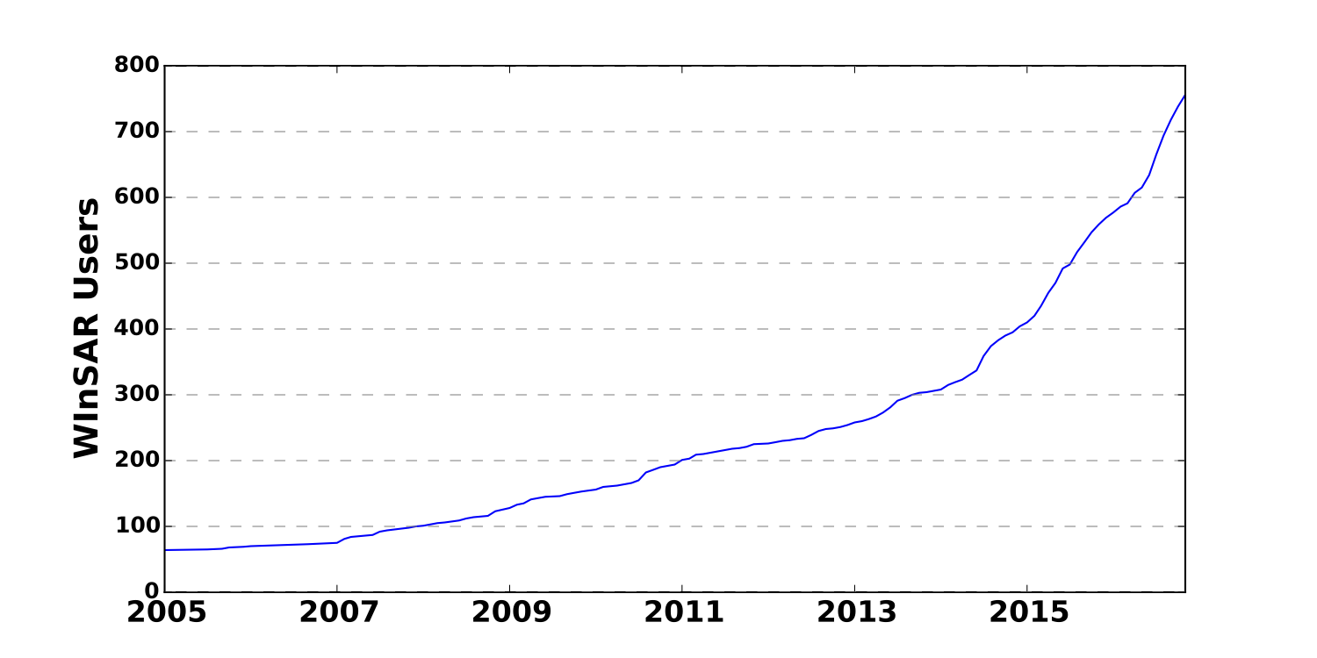
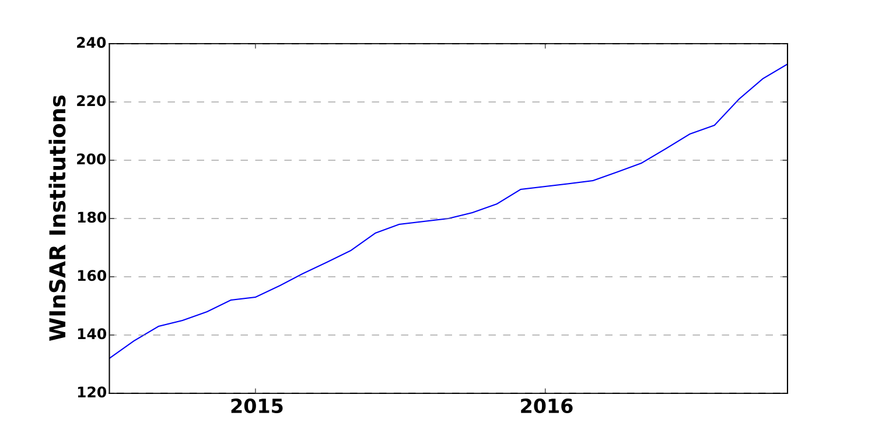
The WInSAR Community
WInSAR Registered Users
WInSAR Institutional Members
Large increase in applications for Adjunct (non-US) membership following ISCE license availability
233 WInSAR Institutional Members = ~750 Registered Users (369 Data Users).
Notes:
Adjunct institutions now approved for ESA data access
ESA data ordering over N. America for full (US) member institutions.
Questions:
Is this still necessary with ESA on-the-fly data ordering policy?
Is there interests to have the SLC data at UNAVCO and shared with the community?

Slide 4
WInSAR Activities
WInSAR Web Updates (early 2017)
Combined WInSAR website and Portal
Streamlined institutional applications
Publication interface for users to share references
Improved proposal management interface
Proposals
Proposals added in the last year:
3 new DLR proposals
8 new JAXA proposals
JAXA proposals have contributed to largest increase in data volume
Request for ASI CSK proposal management
TanDEM-X proposal management anticipated
TSX background tasking: no new proposals added to WInSAR
REMINDER: Archive proposals need to be written and data “shared” through WInSAR for areas to remain on the tasking
Mission | Scene count | Size, GB
ALOS | 756 | 545
ALOS-2 | 1133 | 43966
COSMO-SkyMed* | 959 | 454
Envisat | 24904 | 4553
ERS-1 | 10369 | 3706
ERS-2 | 32382 | 8013
Radarsat-2* | 455 | 268
Radarsat-1 | 24884 | 12034
Sentinel-1 | 729 | 2128
TerraSAR-X | 2273 | 2287
TOTAL | 98844 | 75953 GB
*Supersites collections at UNAVCO

Slide 5


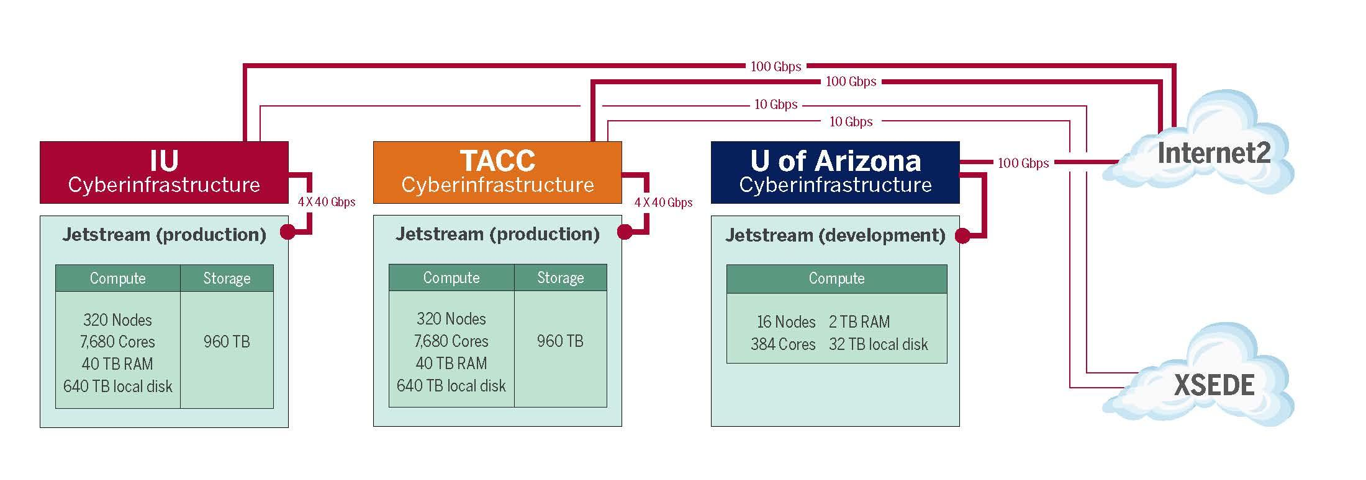
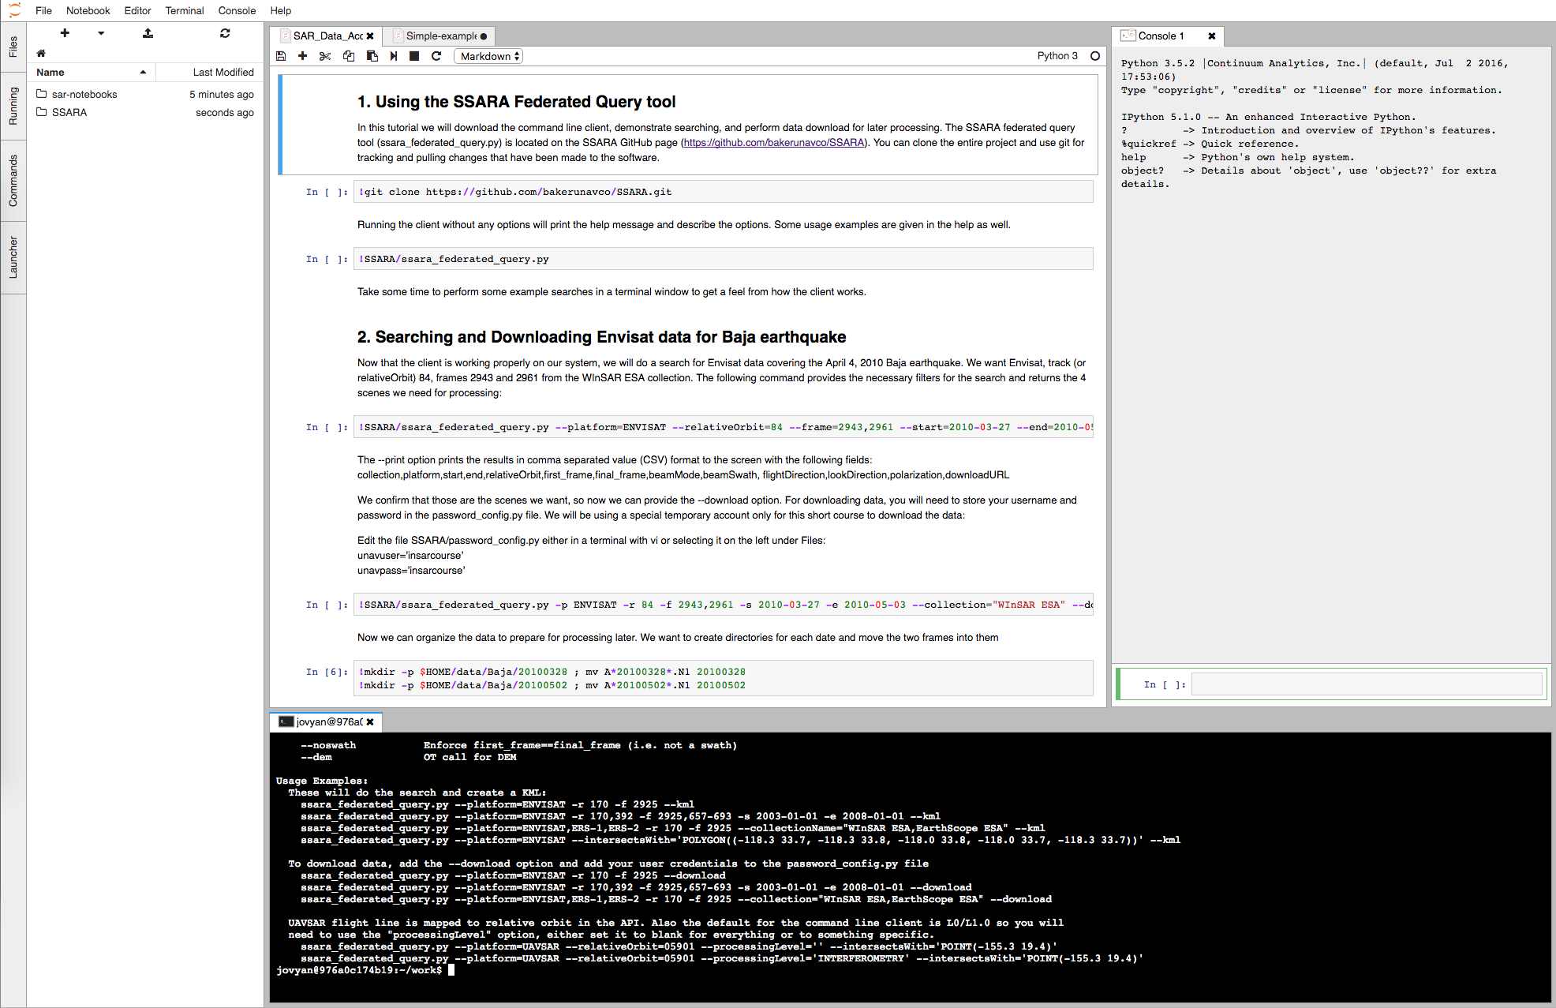
SAR Archive cloud migration
Cloud storage and computing at XSEDE/TACC
Copy of SAR data on TACC’s wrangler HPC
    Co-locate data and computing
    Improved bandwidth for SAR archive downloads
Jetstream: scalable cloud environment
    SAR data processing and analysis (JupyterHub and GMTSAR)
Users can apply for XSEDE allocations separately if more computing resources are necessary
http://jetstream-cloud.org/files/Jetstream_XSEDE15-2015_jul_28.pptx
See poster G43A-1037 on Thursday

