Slide 1
WInSAR Operations Update
Christopher Crosby & Scott Baker
AGU WInSAR Business Meeting,
December 16, 2015

Slide 2
WInSAR Operations
WInSAR Funding
Limited WInSAR support under GAGE Facility
- ~1 FTE for management, archive ops and maintenance, tasking, data ordering, data ingest, website and community support
- SSARA NASA ROSES ACCESS award ends March, 2015.
Supplemental support:
- $100k SAR supplement ($50k NSF/$50k NASA)
- $55k- Enhancing Access to UNAVCO Imaging Data - awarded to support SAR web service development and integration with existing UNAVCO services, EarthCube activities.
Activities
WInSAR Portal:
- ALOS-2 data management
SSARA (NASA ROSES ACCESS funded):
Federated SAR data search and download (ASF, UNAVCO, Supersites)
InSAR product archive
ISCE licenses and software distribution:
Facilitating distribution, providing help desk support for ISCE users.
Large increase in Adjunct II applications for ISCE access

Slide 3
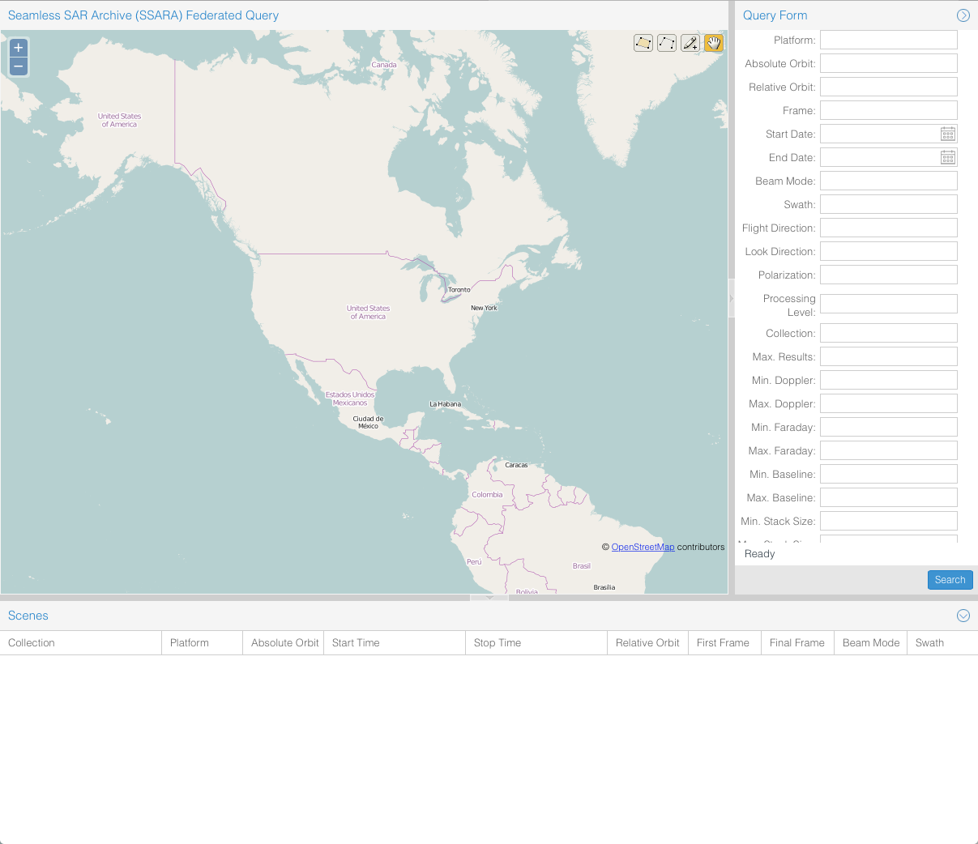
WInSAR Operations
Data & Access
Contact: winsar@unavco.org | supersites@unavco.org
Mission | Scene Count | Data Size, GB
COSMO-SkyMed* | 739 | 351
ENVISAT | 24801 | 4538
ERS-1 | 10236 | 3679
ERS-2 | 32176 | 7978
Radarsat-1 | 24884 | 12033
Radarsat-2* | 352 | 221
Sentinel-1a | 719 | 2122
TerraSAR-X | 1843 | 1954
TOTAL: | 95870 | 35932
*Supersites Collections at UNAVCO
http://web-services.unavco.org/brokered/ssara/gui2.0
Notes:
Note:
CSK and RS2 are Supersites collections, so potentially anyone can access those data after contacting the Supersites PoC.
Radarsat-1 STF swath have been converted into CEOS format as swaths and the irregular frames were removed

Slide 4
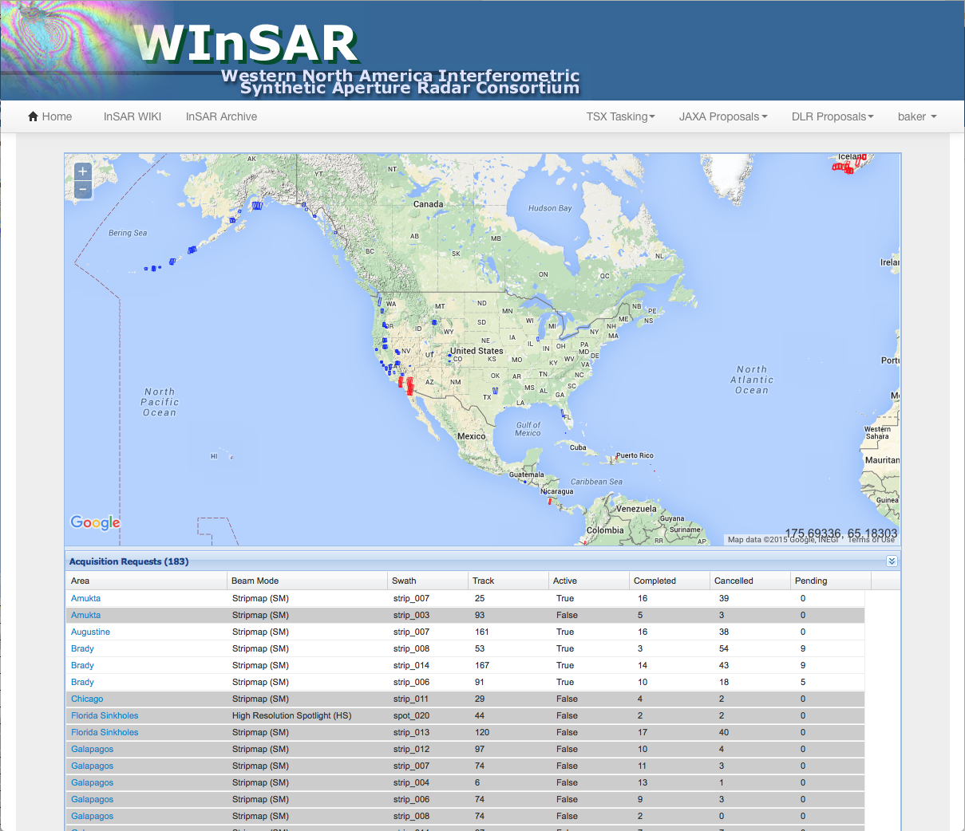
WInSAR TSX Background Tasking
Some tasking areas have been successful and others have not, approx. 37% success rate overall
DLR now has unlimited “archive” proposals to acquire data older than 18 months for free
Archive proposals need to be written and data “shared” through WInSAR for areas to remain on the tasking
https://winsar.unavco.org/portal/requests/
https://winsar.unavco.org/portal/tasking/summary/
Notes:
community needs to write archive proposals to acquire these data for the UNAVCO archive.

Slide 5
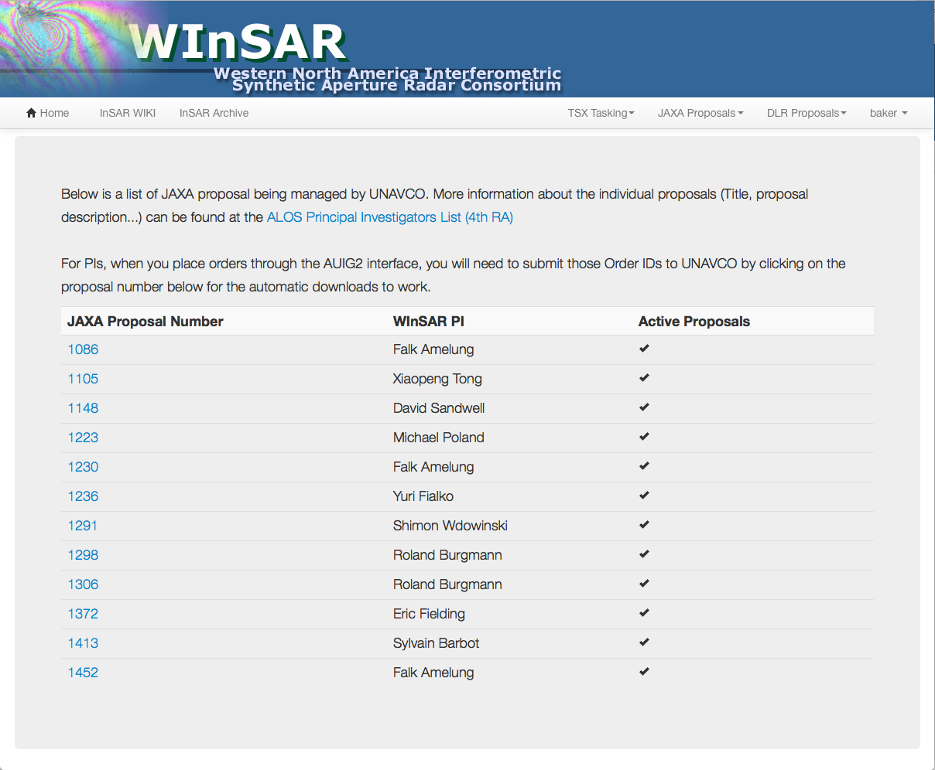
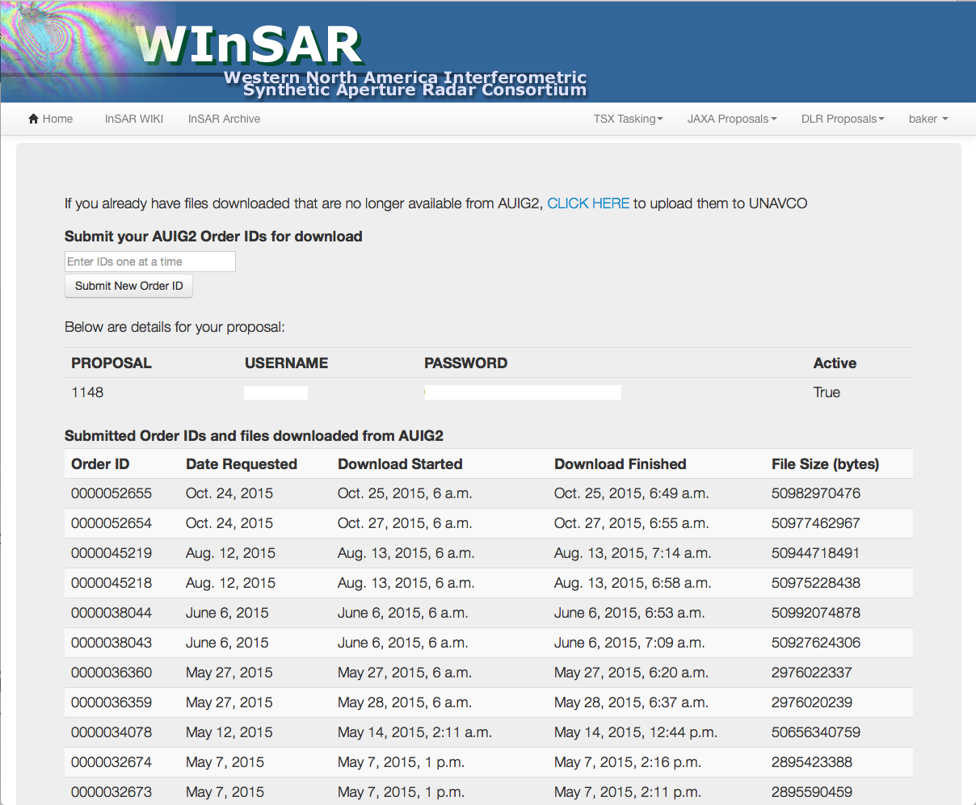
ALOS-2 PI Proposals
Similar interface to DLR proposals. PI uploads proposal info and license agreement
When you place orders through the AUIG2 interface, you will need to submit those Order IDs to UNAVCO for the automatic downloads to work
https://winsar.unavco.org/portal/jaxaproposals/
https://winsar.unavco.org/portal/jaxaproposals/info

Slide 6
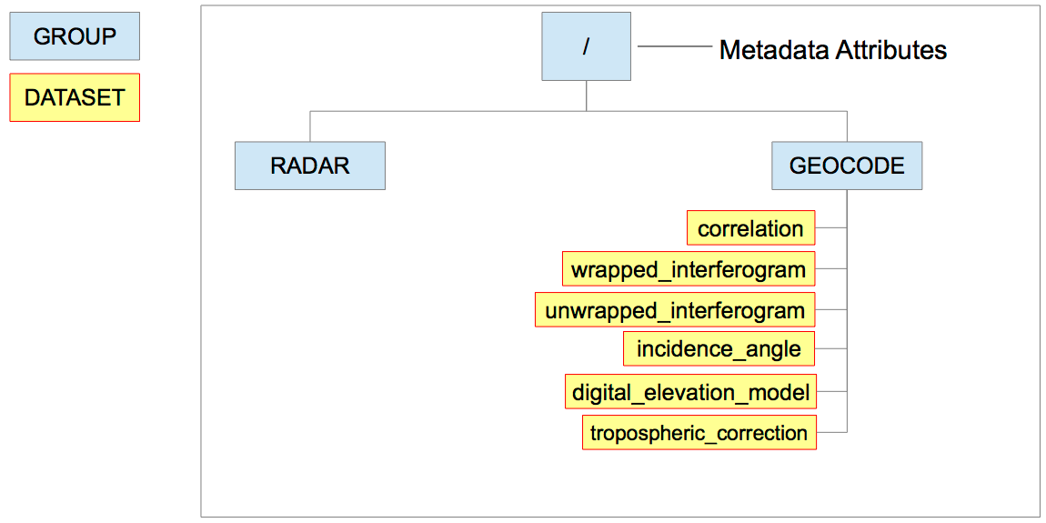
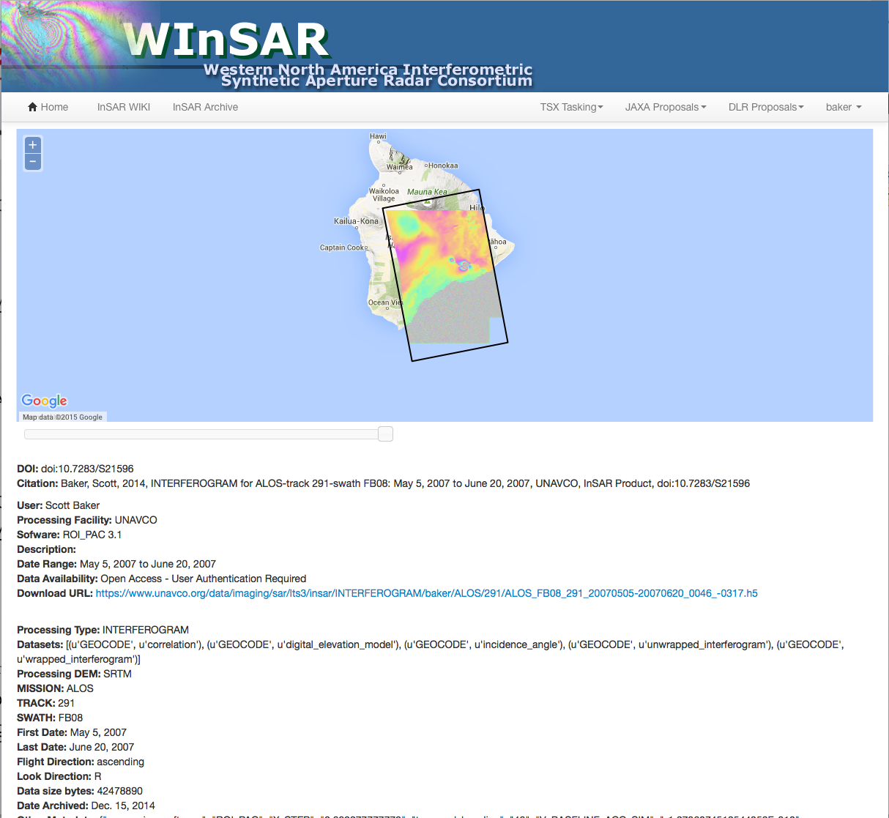
InSAR Product Archive
Developed under the SSARA project to provide a community-contributed InSAR archive for interferograms, time series, and other derived data products.
https://winsar.unavco.org/portal/insar
HDF5 format is used for the data products. Example converters for ROI_PAC, ISCE, and GMTSAR provided on SSARA GitHub repository
REST interface for uploading interferograms (LOS velocities and LOS time series support in development) https://winsar.unavco.org/portal/insar/api/
Data can also be uploaded from the command line using cURL: curl -i -F data_file=@DATA_FILENAME -u USERNAME:PASSWORD https://winsar.unavco.org/portal/insar/api/interferometry/ Users only need to provide the "data_file" parameter via POST method along with their login credentials since all necessary metadata is read from the HDF5 file directly.
Original HDF5 Format
Notes:
Under the NASA-funded seamless SAR archive (SSARA) project (Figure 1) led by UNAVCO [Baker et al., 2014], a user-contributed InSAR archive for interferograms, time series, and other derived data products has been developed at UNAVCO. The InSAR archive is based on a standard HDF5 data format and provides storage, distribution, and sharing of research results within the geodesy community. The hierarchical data format release 5 (HDF5) [HDF Group, 2014] is the preferred format for InSAR data products because it provides a more robust set of features for storing data. HDF5 has been adopted by the Alaska Satellite Facility (ASF) and is also used in InSAR time series analysis software packages such as GIAnT from Caltech [Agram et al., 2013]. When dealing with a single geocoded interferogram, netCDF or HDF5 work equally well for storing the data. With more complicated scenarios such as stacks of interferograms or distribution of both geocoded and radar geometry interferograms, the hierarchical data features of HDF5 become important, in particular the ability to create groups within a single HDF5 file. The standard HDF5 data products (Figure 2) provide all the necessary datasets and relevant metadata in a single file for distribution. Support for reading and writing HDF5 is available in many programming languages (C/C++, Fortran, Python, Java), and Matlab versions 7.3 and higher use an HDF5-based format for their MAT-file storage, thus providing native reading and writing of HDF5 files.
HDF5 layout for an interferogram data product. The HDF5 data products in the UNAVCO InSAR archive are organized into groups with datasets contained within each group. Metadata is stored as attributes at the root level and have a set of required attribute names, but additional metadata can be assigned to the groups or datasets as well. A similar stucture is used for LOS velocties and LOS time series data products.
InSAR product archive web interface. The API has a basic browsable web interface that lists InSAR products and, if users are authenticated, allows for submission of products to the archive. A basic map interface is available that shows locations of interferograms with enhanced functionality planned for future development.

Slide 7
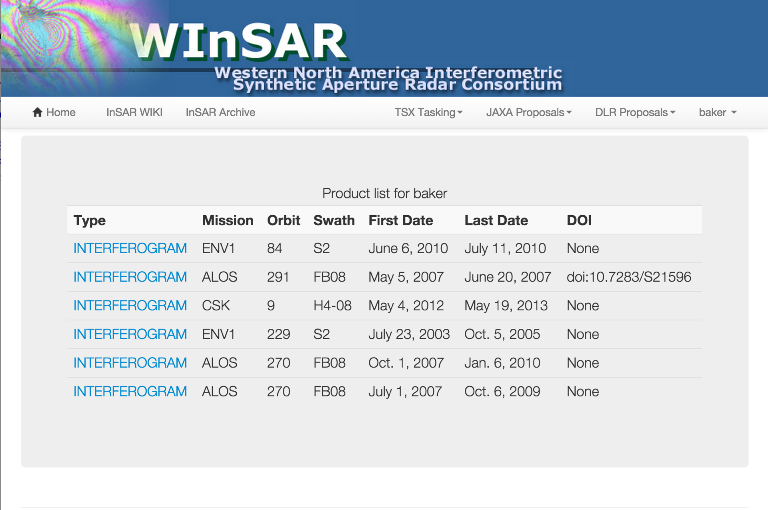
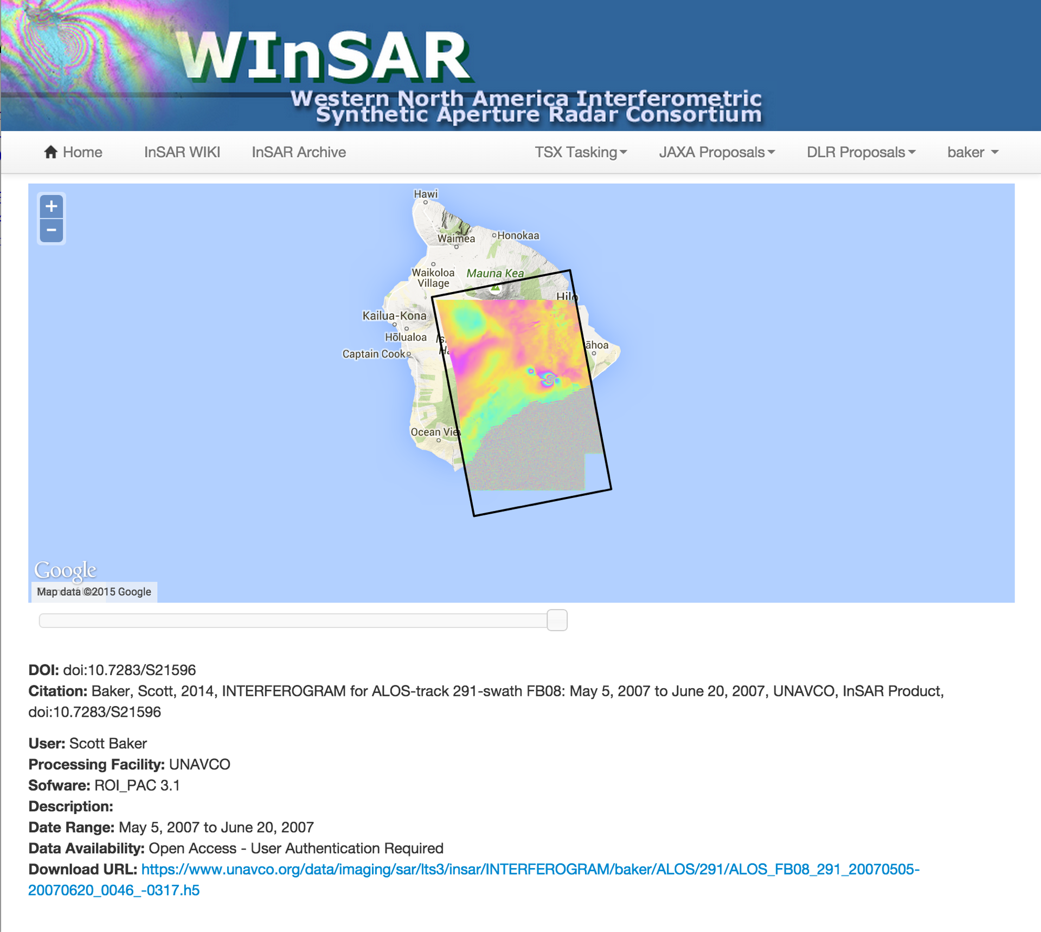
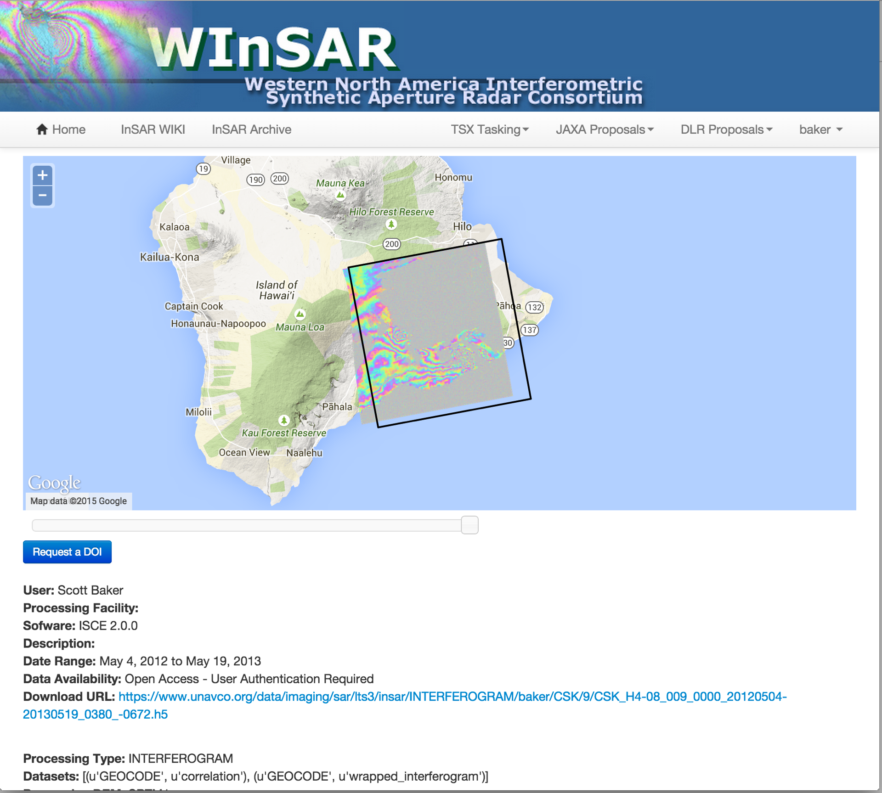
InSAR Product Archive - DOI Integration
DOI Request:
On the product page, there is a “Request a DOI” button
Once DOI is minted, the products are permanently in the archive
DOI links to the WInSAR portal product page
http://dx.doi.org/10.7283/S21596
Users can view their uploaded products
and assigned DOIs:
https://winsar.unavco.org/portal/insar/mine
Notes:
Under the NASA-funded seamless SAR archive (SSARA) project (Figure 1) led by UNAVCO [Baker et al., 2014], a user-contributed InSAR archive for interferograms, time series, and other derived data products has been developed at UNAVCO. The InSAR archive is based on a standard HDF5 data format and provides storage, distribution, and sharing of research results within the geodesy community. The hierarchical data format release 5 (HDF5) [HDF Group, 2014] is the preferred format for InSAR data products because it provides a more robust set of features for storing data. HDF5 has been adopted by the Alaska Satellite Facility (ASF) and is also used in InSAR time series analysis software packages such as GIAnT from Caltech [Agram et al., 2013]. When dealing with a single geocoded interferogram, netCDF or HDF5 work equally well for storing the data. With more complicated scenarios such as stacks of interferograms or distribution of both geocoded and radar geometry interferograms, the hierarchical data features of HDF5 become important, in particular the ability to create groups within a single HDF5 file. The standard HDF5 data products (Figure 2) provide all the necessary datasets and relevant metadata in a single file for distribution. Support for reading and writing HDF5 is available in many programming languages (C/C++, Fortran, Python, Java), and Matlab versions 7.3 and higher use an HDF5-based format for their MAT-file storage, thus providing native reading and writing of HDF5 files.
HDF5 layout for an interferogram data product. The HDF5 data products in the UNAVCO InSAR archive are organized into groups with datasets contained within each group. Metadata is stored as attributes at the root level and have a set of required attribute names, but additional metadata can be assigned to the groups or datasets as well. A similar stucture is used for LOS velocties and LOS time series data products.
InSAR product archive web interface. The API has a basic browsable web interface that lists InSAR products and, if users are authenticated, allows for submission of products to the archive. A basic map interface is available that shows locations of interferograms with enhanced functionality planned for future development.

Slide 8
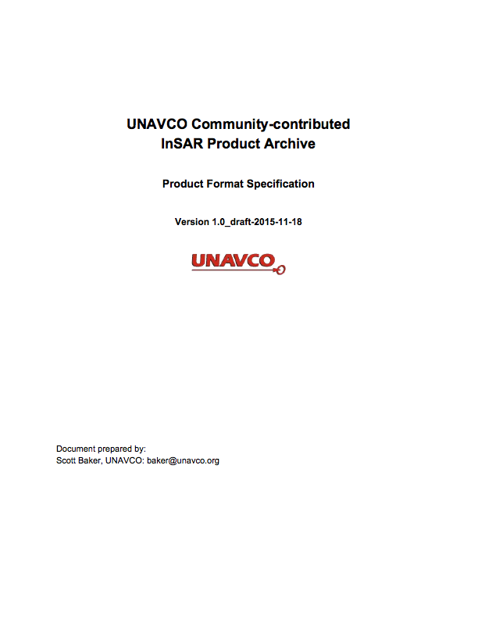
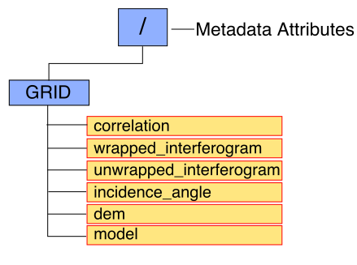
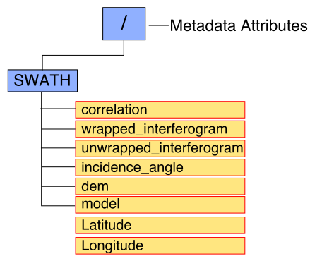
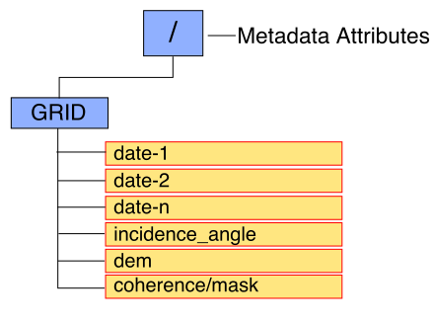
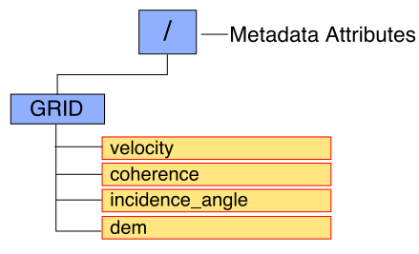
InSAR Product Archive - HDF-EOS5
Adoption of NASA’s HDF-EOS5 standard for data products is in progress
https://earthdata.nasa.gov/standards/hdf-eos5
Key benefits of HDF5 and HDF-EOS5:
All datasets and metadata contained within a single data file
Standard convention for georeferencing allowing better integration with GIS software and conversion to other formats (i.e. netCDF and GeoTIFF)
Conventions for storing either geocoded (grids) or radar geometry (swaths) datasets
Geocoded Interferogram
Radar Geometry Interferogram
InSAR Time Series
InSAR LOS Velocities
Notes:
Under the NASA-funded seamless SAR archive (SSARA) project (Figure 1) led by UNAVCO [Baker et al., 2014], a user-contributed InSAR archive for interferograms, time series, and other derived data products has been developed at UNAVCO. The InSAR archive is based on a standard HDF5 data format and provides storage, distribution, and sharing of research results within the geodesy community. The hierarchical data format release 5 (HDF5) [HDF Group, 2014] is the preferred format for InSAR data products because it provides a more robust set of features for storing data. HDF5 has been adopted by the Alaska Satellite Facility (ASF) and is also used in InSAR time series analysis software packages such as GIAnT from Caltech [Agram et al., 2013]. When dealing with a single geocoded interferogram, netCDF or HDF5 work equally well for storing the data. With more complicated scenarios such as stacks of interferograms or distribution of both geocoded and radar geometry interferograms, the hierarchical data features of HDF5 become important, in particular the ability to create groups within a single HDF5 file. The standard HDF5 data products (Figure 2) provide all the necessary datasets and relevant metadata in a single file for distribution. Support for reading and writing HDF5 is available in many programming languages (C/C++, Fortran, Python, Java), and Matlab versions 7.3 and higher use an HDF5-based format for their MAT-file storage, thus providing native reading and writing of HDF5 files.
HDF5 layout for an interferogram data product. The HDF5 data products in the UNAVCO InSAR archive are organized into groups with datasets contained within each group. Metadata is stored as attributes at the root level and have a set of required attribute names, but additional metadata can be assigned to the groups or datasets as well. A similar stucture is used for LOS velocties and LOS time series data products.
InSAR product archive web interface. The API has a basic browsable web interface that lists InSAR products and, if users are authenticated, allows for submission of products to the archive. A basic map interface is available that shows locations of interferograms with enhanced functionality planned for future development.

